Slide 1
for Iteration Statement
ELEC1006: ENGINEERING COMPUTING

Slide 2

Iteration Statement (loops)
Loops are used to repeat a statement a certain number of times when a condition is met.
There are three types of loops:
while loop.
do-while loop.
for loop. ←
PAGE 2

Slide 3
The for Loop
for loop is used when we know how many iterations (loops) are required.
Test each expression before each iteration in the for loop and so, it is known as a pre-test loop similar to while loop.
Note: do-while loop is known as a post-test loop, where the statements executed at least once (one iteration) before the expression is checked.
PAGE 3

Slide 4
for Loop Syntax
The format is:
for (initialisation; expression; increase or decrease)
{
statements
}
– Note: No ; after the )
The mechanics:
Perform initialisation
Evaluate test expression
If true, execute statement
If false, terminate loop execution
Execute update, then re-evaluate test expression
Test
Update
PAGE 4

Slide 5
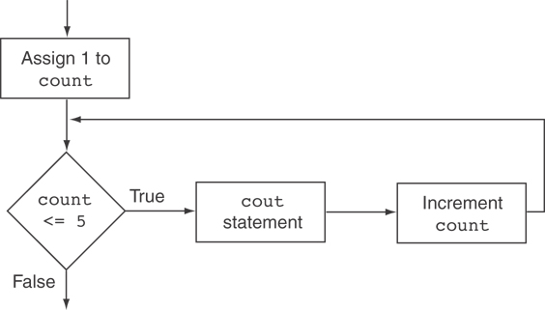
Example
for (int count = 1; count <= 5; count++)
{
cout << "Hello" << endl;
}
Flowchart
PAGE 5

Slide 6
while Loop Equivalent
for (int count = 1; count <= 5; count++)
{
cout << "Hello" << endl;
}
for loop is like an advanced while loop
int count=1;
while (count <= 5)
{
cout << "Hello" << endl;
count++;
}
PAGE 6

Slide 7
Variations using commas
Can also have multiple initialisation and update expressions. Separate the statements with commas ,: int x, y; for (x=1, y=1; x <= 5; x++, y++) { cout << x << " plus " << y << " equals " << (x+y) << endl; }
Initialisations
updates
PAGE 7

Slide 8
Scope of Variables
You can declare variables in the initialisation expression.
Variable i only exist in the for loop { … }, not outside of it.
int sum = 0;
for (int i = 0; i <= 10; i++)
{
sum += i; // sum = sum + i
}
PAGE 8

Slide 9
More info
[1] cplusplus.com: Statements and flow control
https://cplusplus.com/doc/tutorial/control/
[2] learncpp.com: 5.7 – For statements
https://www.learncpp.com/cpp-tutorial/57-for- statements/
PAGE 9

